Slide 1
Maximize Your Student Participation
Provided by the LAUSD Food Services Division
July 20, 2016
Notes:
THIS IS JUST A PLACE HOLDER FOR SCREEN BEFORE THE PRESENTATION IS READY TO BEGIN

Slide 2
Maximize Your Student Participation
Provided by the LAUSD Food Services Division
July 20, 2016
Notes:
TELL: Hello. And welcome, today we will go over how to Maximize your student participation during all meal serving periods. This is an in depth look at what effects participation and strategies you can implement increase participation.

Slide 3
Overview
Café LA is striving to increase participation by providing nutritious meals and implementing new techniques and strategies that keep up with the competition and choices available to our students.
To maximize participation we will go over:
Customer types and how to establish buy-in
An effective approach that involves DPIE (Diagnose, Prescribe, Implement, Evaluate)
Factors affecting participation
Notes:
TELL: Café LA is striving to increase meal participation by providing nutritious meals and implementing new techniques and strategies that keep up with the increase in competition and choices that are accessible to our students. We will discuss how to maximize participation by identifying your customers and establishing buy-in with them, utilizing an effective approach to increase participation that involves DPIE (Diagnose, Prescribe, Implement, and Evaluate), along with to recognizing factors that can affect participation at your school site.

Slide 4
Objective
Food Services motivates students to select nutritious foods by employing research based principles and nourishing children to achieve excellence.
This customer focused service:
Creates a positive environment that maximizes participation to sustain the operation daily
Utilizes strategies and tools provided to maximize efficiency within the Food Services Division
Notes:
TELL: Food Services motivates students to select nutritious foods. As Cafe LA employees we help to facilitate this goal by employing research based principles that assure quality and help us continue with our commitment to nourish children to achieve excellence. This customer focused service helps to foster a positive environment that maximizes participation in your daily operation and utilizes strategies and tools provided to maximize efficiency within the Food Services Division.

Slide 5
Increasing Participation
Increasing participation grows your customer base and generates more revenue for the Food Services Division.
Maximizing student participation will:
Expand the reach of our meal programs to support the health and academic needs of students
Reduce the encroachment on the General Fund
Support ongoing employment opportunities within the Food Services Division
Notes:
TELL: Increasing participation is more than just a numbers game, participation grows the customer base and generates more revenue for the Food Services Division. Increasing participation requires the use of multiple strategies and suggestions to be successful. By increasing participation we can expand the reach of our meal programs to support the health and academic needs of students. Additionally, the increased revenue reduces our encroachment on the General Fund which supports the ongoing employment opportunities within the Food Services Division.

Slide 6
Know Your Customers
There are three customer types. Understanding your customers beliefs and perceptions will equip you with the tools to meet their wants and needs. This will lead to building buy-in within your meal program.
Buy-in takes place when customers agree to give support and accept ideas
Primary Customer | External Customer | Internal Customer
Students | Faculty, Parents, Administrators | Staff
Notes:
TELL: Any conversation regarding participation and building customer buy-in must begin by understanding who your customers are. Buy-in takes place when customers agree to give support and accept ideas. We will discuss 3 customer types that will focus on: the primary, external, and internal customers. The primary customer consists of our students. The external customers not to be confused with external students, are the faculty, parents, and administrators. This does not mean they are less important than our primary customers, in fact, external customers heavily influence the decisions of primary customers. Last but not least, we have our internal customers, who are the driving force behind the movement towards everyone having a “Café LA Day”. Let’s begin by taking a closer look at the primary customer on the next slide.
Click next slide

Slide 7
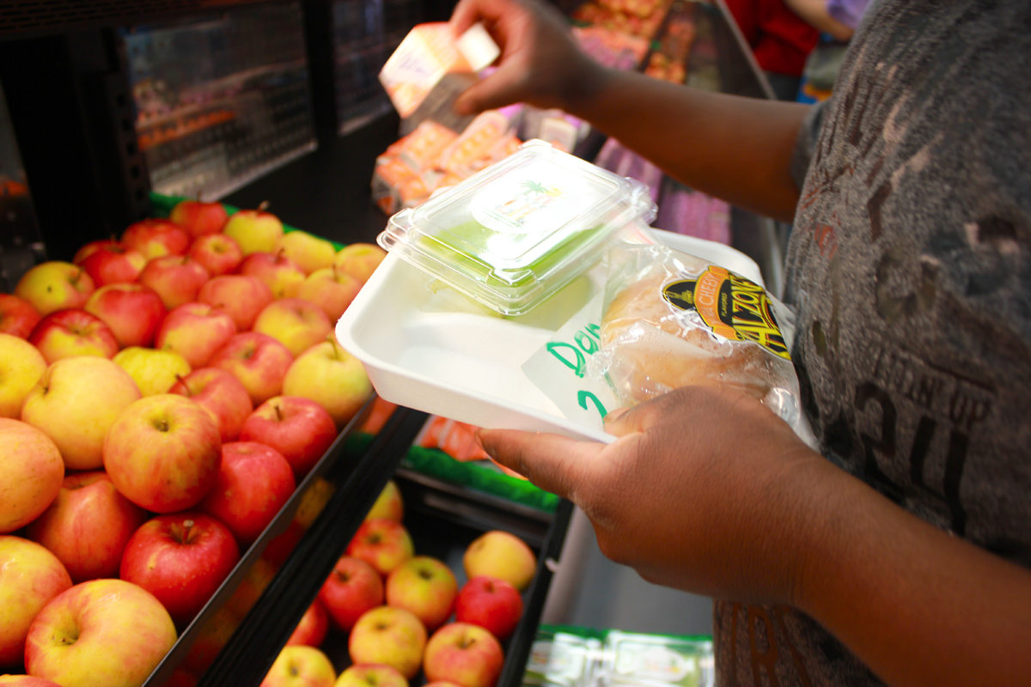
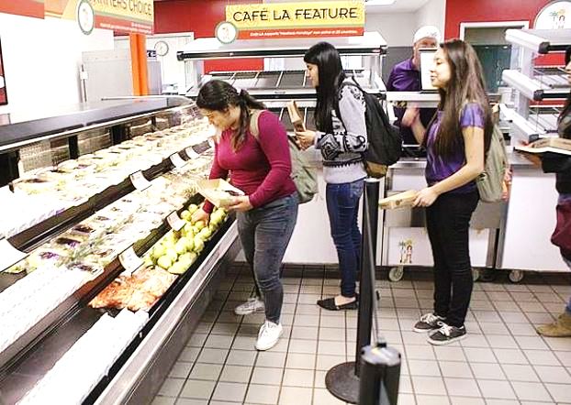
Primary Customers
Our primary customers are classified as Generation Z. These customers are more aware of healthy food choices, making them the most health conscious generation.
We’re not just feeding them food, we’re developing good eating habits and a healthier lifestyle.
Notes:
TELL: Our primary customer is generation Z. Defined as anyone born after 1995, generation Z makes up about 26 percent of the population, the largest demographic since Baby Boomers. These young customers make up 100% of our primary customer population here at Café LA. This generation is more aware than ever about healthy food choices, making them the most health conscious generation we’ve ever seen. To get your primary customers to buy-in to your Café LA, feed their health conscious habits and further develop their healthy eating habits to support their healthy lifestyles.

Slide 8
Marketing Nudge to Create Buy-In
Marketing Nudges
Customer Engagement
Visual Aid Marketing
Influence
Café LA Pride
Nudging is the act of encouraging students towards healthier choices and participation in Café LA meal programs.
Notes:
TELL: Sometimes, even these health conscious customers need a bit of encouragement towards healthier choices in the lunchroom. As a Food Service Manager it is your job to provide customers with a marketing nudge towards enhancing their experience and making them want to keep coming back. This is not a physical nudge. (animation 1)This “marketing nudge” can be achieved by simply paying attention to these 4 concepts. (animation 2) In order to create buy-in from our primary customers we should engage with them by answering all of their questions with a friendly attitude that invites them to our Café LA. (animation 3) Incorporate visuals to facilitate the selection process and enhance the experience by marketing our healthier choices (animation 4). Focus on building a good rapport with student’s families, friends, and teachers because of their influence towards this customers eating behaviors (animation 5).Most importantly, take pride in your café LA site, this will allow you to build a natural environment that is positive and enhances the customer experience. These marketing nudges will assist towards increasing participation.

Slide 9
External Customers
External customers have a large influence on the decisions of our primary customers and include: faculty, parents, and administrators.
Communicate with external customers and share the many benefits Café LA has to offer and have them pass the message to the students.
Notes:
TELL: Faculty, parents, and administrators are external customers who, as we alluded to in the previous slide, carry a large influence on our primary customers eating habits. Communicate the benefits in a clear way so that these external customers can represent our brand outside the cafeteria. When a student talks about our cafeteria in the classroom, a teacher can be there to shed positive light and influence student participation. The same goes for parents who, for the most part, make the decisions of what a student will eat while at school. Create buy-in with external customers by keeping them informed of the benefits of Café LA.

Slide 10
Buy-In From External Customers
Support from Administration & Parents
Schedule Time
This creates an environment for a conversation with no distractions.
Follow Up
Consistent communication answers questions and addresses concerns.
Communicate Strategies
Discuss efforts that will be made to increase participation.
Notes:
TELL: In order to obtain buy-in from our external customers and generate the support system needed to increase participation, (animation 1) start with scheduling time with both parents and administrators to have a productive conversation that is free of distractions. (animation 2) During that time, communicate the strategies and efforts being made by your cafeteria to increase participation. Finally, (animation 3) follow up with external customers to create a consistent communication cycle that answers questions and addresses concerns moving forward.

Slide 11
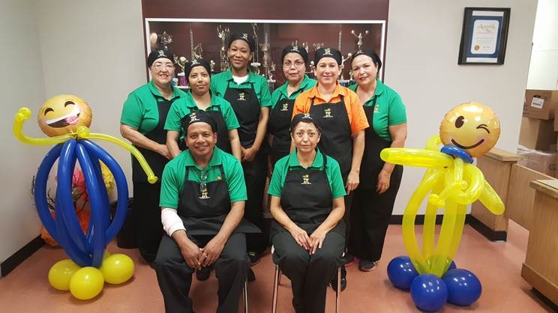
Internal Customers
Internal customers are the Café LA staff in charge of providing service to the primary customers. If your staff works collectively and utilizes fresh ideas and approaches, it will translate to an increase in participation.
Notes:
TELL: The final customer type impacting your participation is the internal customer. Our internal customer consists of your Café LA staff and support team. This customer group is in charge of providing service to the primary customers, consider them being the engine going on the train of success. With your team working collectively, utilizing fresh ideas and approaches, your meal programs will benefit greatly. Work on developing your staff’s skills and confidence to have them support your goal of increasing participation.

Slide 12
Buy-In From Internal Customers
Recognize your teams contributions and use customer feedback to build a successful meal program.
Empower your team to have a positive presence throughout your campus that promotes Café LA.
Encourage your team to assist customers in a way that makes the experience fun and enjoyable.
Notes:
TELL: To attain buy-in from your internal customers, acknowledge the importance of their interaction with customers and solicit feedback from them in order to build a successful meal program. Another area that can have great influence is empowering your staff to have a presence within the campus that highlights the presence of Café LA. Use this presence to assist customers in a way that makes their Café LA experience fun and enjoyable.

Slide 13
The D-P-I-E Process
D
Diagnose: Determine what is already working and what is not.
P
Prescribe: Recommend changes that could lead to increasing participation.
Implement: Make easy changes which complement your meal program and lead to an increase in participation.
I
Evaluate: Measure and analyze how the changes influence a difference in participation counts after implementation.
E
Notes:
TELL: Inevitably, you will be faced with issues that will affect your participation. Use the DPIE approach to solve participation issues faced during any meal serving period. Yes it’s another acronym but this is simple and won’t take long, I promise. Begin by “Diagnosing” to determine what works and doesn’t work in regards to participation at your school site. Then prescribe recommendations to customize changes that can lead to increasing participation. Next implement easy changes and steps you can make to complement your meal program and lead to increase. Finally evaluate the process by measuring and analyzing how the changes made a difference. Enjoy D-PIE and utilize this resourceful tool to help maximize the participation in your cafeteria. In the coming slides we’ll review scenarios where DPIE can help improve participation and provide examples of completed DPIE issues.

Slide 14
Factors Affecting BIC Participation
Factors that may affect student participation during BIC include:
Unpopular menu items
Classrooms not receiving enough meals
Inaccurate claims made on the classroom roster
Negative influence from external customers
DPIE can help increase participation by simply analyzing your situations and developing solutions.
Notes:
Tell: Beginning with the first meal of the day, you may encounter issues from classrooms with low participation. This can include a high return rate of unpopular men items, classrooms not receiving enough meals, an inaccurate or missing meal count roster, or even negative comments coming from the faculty or administration regarding your BIC program. DPIE can help to increase participation by analyzing the situation systematically and developing solutions.

Slide 15
DPIE Example - BIC
D
Diagnose: Room 43, 44, and 45 have very low participation numbers.
P
Prescribe: Solicit feedback from students and teachers to develop a strategy to observe classroom service
Implement: Utilizing prescribed strategies, add a personal touch by delivering breakfast to low participating classrooms and encouraging students to eat breakfast.
I
E
Evaluate: Determine if an increase occurred after changes were implemented.
Notes:
TELL: As the manager at ABC elementary you start with diagnosing a situation where you notice 3 of your classrooms have very low participation numbers. By soliciting feedback from students and teachers you prescribe changes that allow you to develop a strategy to observe each classroom. Next, we implement a personal touch to those low participating classrooms by simply visiting the rooms and providing the students with a message about the benefits of eating a Café LA. Finally, we evaluate our process to determine if these small changes have led to an increase in your participation.

Slide 16
Factors Affecting Lunch Participation
Factors that may affect student participation during lunch include:
Unpopular menu items served
Students and parents not aware of eligibility and price of meals
Students not coming to the cafeteria
Competition (competitive sales and home packed lunch)
Campus activities
DPIE can help you to increase participation by simply analyzing your situations and developing solutions.
Notes:
Tell: During lunch time, issues like an unpopular menu item are only made worse by students and parents being unaware of their meal eligibility and meal pricing. Students not visiting the cafeteria, whether it’s because of alternative food choices, or even campus activities that reduce attendance; DPIE can help to develop strategic solutions to today’s cafeteria.

Slide 17
DPIE Example - Lunch
D
Diagnose: A large percentage of the students are eating lunch brought from home.
P
Prescribe: Reach out to those customers to determine what factors are preventing them from choosing Café LA as their dining choice.
I
Implement:. Attend Back to School Night and address students and parents about the nutritional and economic benefits of eating at Café LA
E
Evaluate: Determine if an increase occurred after changes were implemented.
Notes:
Tell: For lunch, we’ll start with diagnosing that a large percentage of students are eating lunch brought from home, we are going to prescribe that as a team we reach out to those customers to find out what factors are preventing them from choosing Café LA as their dining choice. As a manager you may decide to get approval from a supervisor to attend back to school night to address students and parents about the nutritional and economic benefits of eating at Café LA, this would be considered your stage of implementing what you prescribe as a solution. After that, evaluate the effects of your outreach by using the monthly participation tally sheet to determine if the communication you’ve implemented had a positive effect in participation.

Slide 18
Factors Affecting Supper Participation
Factors that may affect student participation during Supper include:
Student preference between shelf stable and fresh meals
Time that supper is distributed by program(s)
Unpopular menu items
Not reaching out to community
DPIE can help you to increase participation, identify the correct slice of DPIE in the following activity.
Notes:
TELL: Supper participation may be affected by student preferences of fresh food versus dry foods, the time that supper is distributed, and the introduction of new items that can intimidate students. In the next slides, we will practice identifying stages of DPIE by providing you with scenarios that are part of the D-P-I-E process and then review the results it can give us.

Slide 19
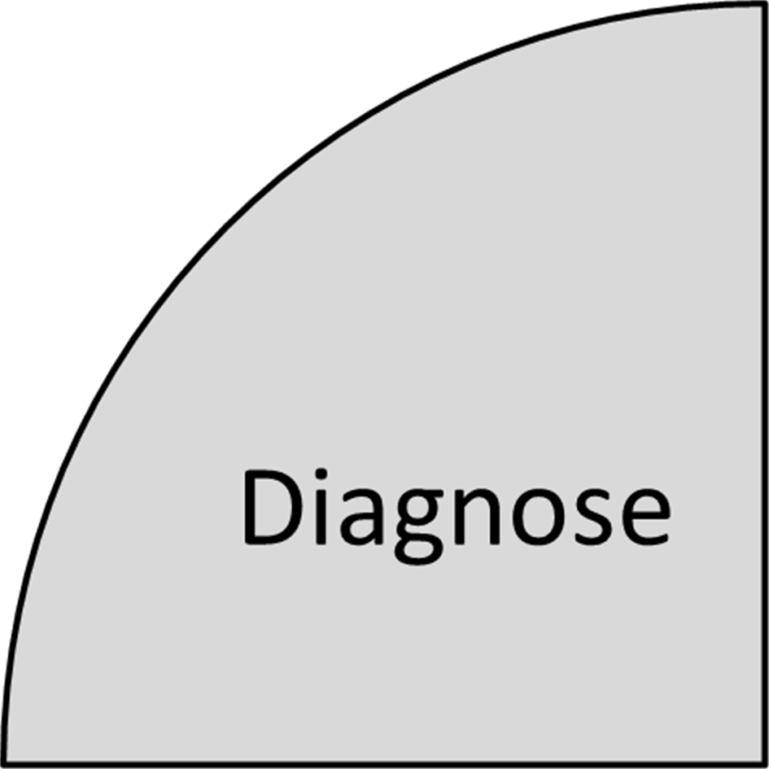
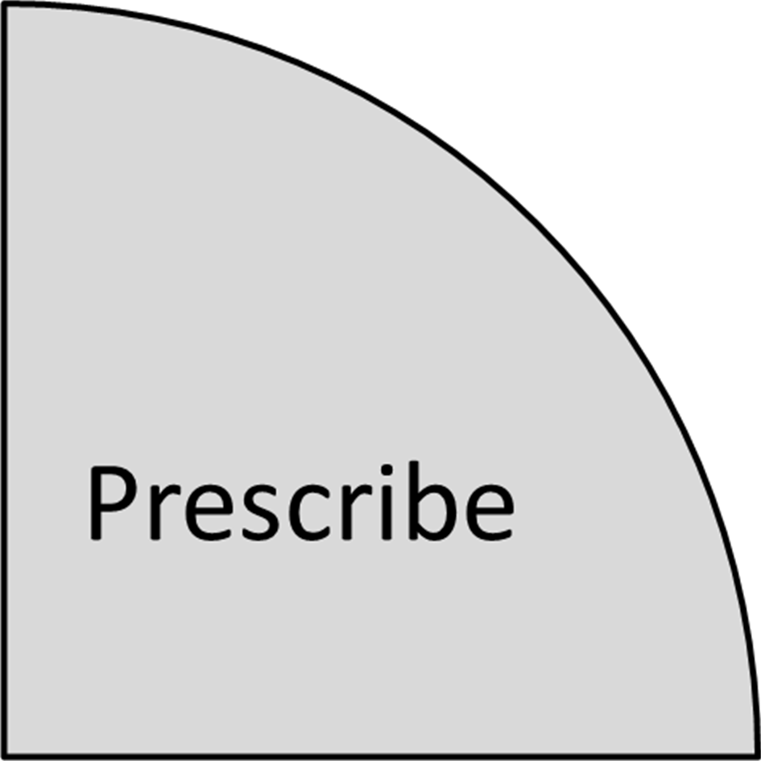
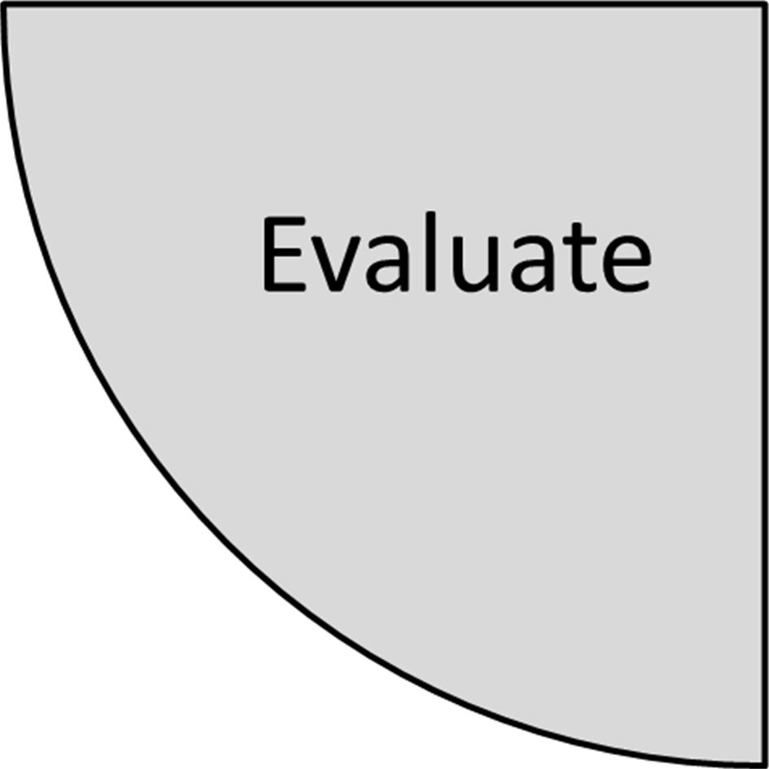
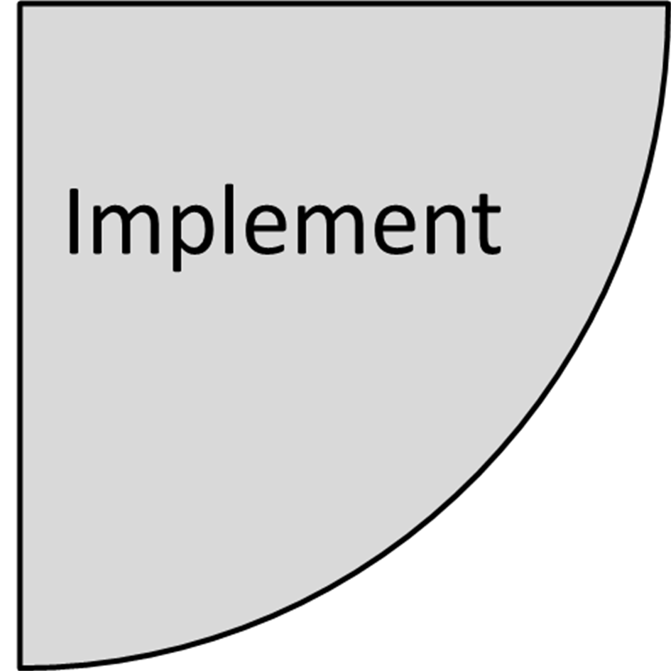
D-P-I-E In Action
You notice a major decline in student participation on Tuesday’s and Wednesday’s.
What slice of D-P-I-E is this?
Click on the correct slice to continue
Notes:
Tell: You noticed that on Tuesday’s and Wednesday’s there is a major decline in student participation.
What slice of D-P-I-E is this?
Click on the correct slice of D-P-I-E to continue

Slide 20
D-P-I-E In Action
You realize on Tuesday and Wednesday you are serving the shelf-stable meals. You switch to serving fresh supper meals on those days.
What slice of D-P-I-E is this?
Click on the correct slice to continue
Notes:
Tell: You realize on Tuesday and Wednesday you are serving the shelf-stable Goldstar items so you change it to fresh supper items for the next order.
What slice of D-P-I-E is this?
Click on the correct slice of D-P-I-E to continue

Slide 21
D-P-I-E In Action
Review menu on low participation days to determine possible causes.
What slice of D-P-I-E is this?
Click on the correct slice to continue
Notes:
Tell: Review menu’s for the 2 days in question to determine difference.
What slice of D-P-I-E is this?
Click on the correct slice of D-P-I-E to continue

Slide 22
D-P-I-E In Action
Determine if an increase occurred after changes were implemented.
What slice of D-P-I-E is this?
Click on the correct slice to continue
Notes:
Tell: You realize your participation numbers increase the week that you serve Goldstar Fresh items on Tuesday and Wednesday.
What slice of D-P-I-E is this?
Click on the correct slice of D-P-I-E to continue

Slide 23
Increasing Participation-Supper
D
Diagnose: You notice a major decline in student participation on Tuesday’s and Wednesday’s.
P
Prescribe: Review menu on low participation days to determine possible causes.
Implement: You realize on Tuesday and Wednesday you are serving the shelf-stable meals. You switch to serving fresh supper meals on those days.
I
E
Evaluate: Determine if an increase occurred after changes were implemented.
Notes:
Tell: Great job!
Here is a summary of the DPIE process we identified in our supper example. Our diagnosis determines on Tuesdays and Wednesdays a major decline in student participation occurs. Our prescription is the review of the menu on low participation days to determine the possible causes for the participation drop. Our implementation comes after realizing that on Tuesdays and Wednesdays we serve shelf-stable meals and switching to serving fresh supper items. We then evaluate our changes to determine if an increase in participation did occur and continue with our success.

Slide 24
Increasing Participation
Use DPIE to develop strategies to increase participation for each serving period: breakfast, lunch, snack and supper.
Increasing participation is an obtainable goal when using DPIE.
Notes:
TELL: Moving forward, use DPIE to develop strategies to improve participation at your school site during any serving period. This tool takes on challenges by using a systematic approach to problem solving that allows you to obtain an increase in your cafeteria’s participation.

Slide 25
Factors Affecting Participation Increase
Addressing the top customer concerns in food service will resolve many customer complaints before they begin.
Be proactive in attending to:
Customer service – 29%
Ambiance – 27 %
Food quality – 22%
Convenience and timing – 13%
Value and price – 9%
Notes:
Tell: Working to address the issues that most frequently affect customer satisfaction is a proactive step that can address many issues before they negatively impact your operation and require a DPIE approach. After surveying 45 responses, customer service was ranked as the most important factor affecting a customers decision to visit a food establishment with 29%. This was closely followed by the ambiance at 27%, food quality at 22%, convenience and timing of food at 13%, and at the value and price of food at 9%. In the next slides, let’s look at how Café LA’s brand can benefit from addressing the top five customer concerns.

Slide 26
The Café LA Brand
Developing the Café LA brand at your school site will increase participation. Brand development creates a feeling of trust between customers and Café LA where students look forward to having a Café LA meal.
The more you promote the brand, the more buy-in you gain.
Notes:
TELL: The development of the Café LA brand at your school site translates to an increase in participation. Brand development creates trust between customers and Café LA that all their needs will be met and they will have a great Café LA meal. The more you promote the brand, the more buy-in you gain.

Slide 27
Customer Service
You and your staff are the brand ambassadors for Café LA. Train and motivate your staff to live and breathe the brand to help promote a positive image of the cafeteria so that participation continues to increase.
Notes:
TELL: Are customers thinking about our brand outside of the four walls of the cafeteria? Mentally, we want customers to think about Café LA positively all throughout the day. As the messenger to the team that goes out to represent the brand, we must train and motivate our staff to project a positive image of our business. This will enable us to continuously reach potential buyers and create brand linked memories that students can remember when they are outside of the cafeteria.

Slide 28
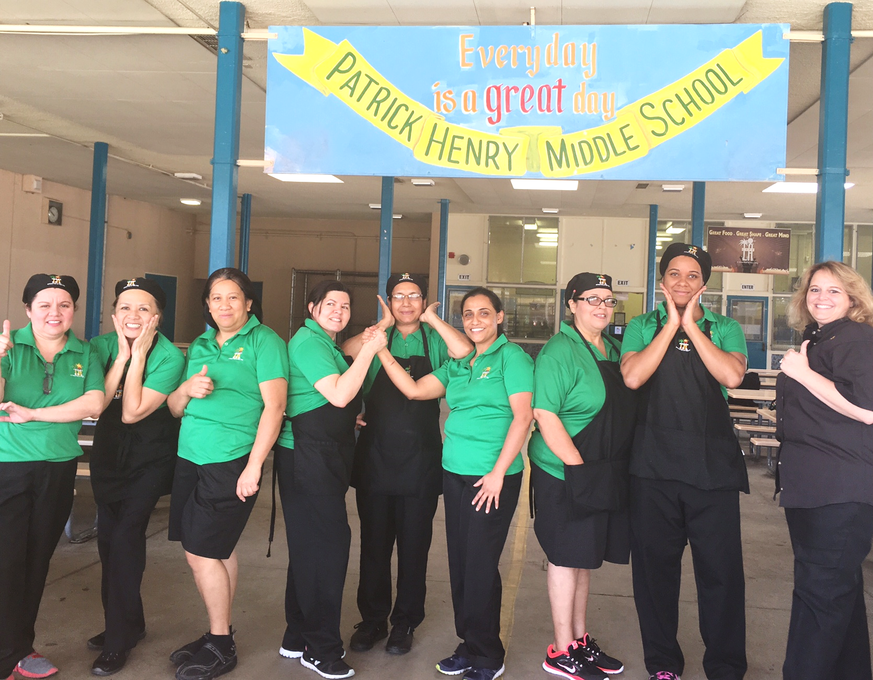
Food for Thought-Activity
Is the staff pictured representing the Café LA brand the way we would like?
Click on the correct answer below to continue
YES
OR
Notes:
TELL: Is the staff pictured representing the Café LA brand the way we would like?
Click on the correct answer below to continue

Slide 29
Food for Thought-Activity
YES
This photo shows what Café LA is about with teamwork and a smile for our customers we can increase participation.
Notes:
TELL: Correct, this photo shows what Café LA is about with teamwork and a smile for our customers we can increase participation

Slide 30
The Ambiance
Applying changes to the physical concepts of your cafeteria will deliver your Café LA focused message through tangible visual aids and incorporates:
Posters and signs
Music and other effects
Decor
A focus on cleanliness
Notes:
TELL: Applying changes to the physical concepts of your cafeteria will deliver your Café LA focused message through tangible visual aids in a clean environment that incorporates colorful posters and signs, appropriate music and other effects, seasonal décor when necessary, and a consistent focus on cleanliness.

Slide 31
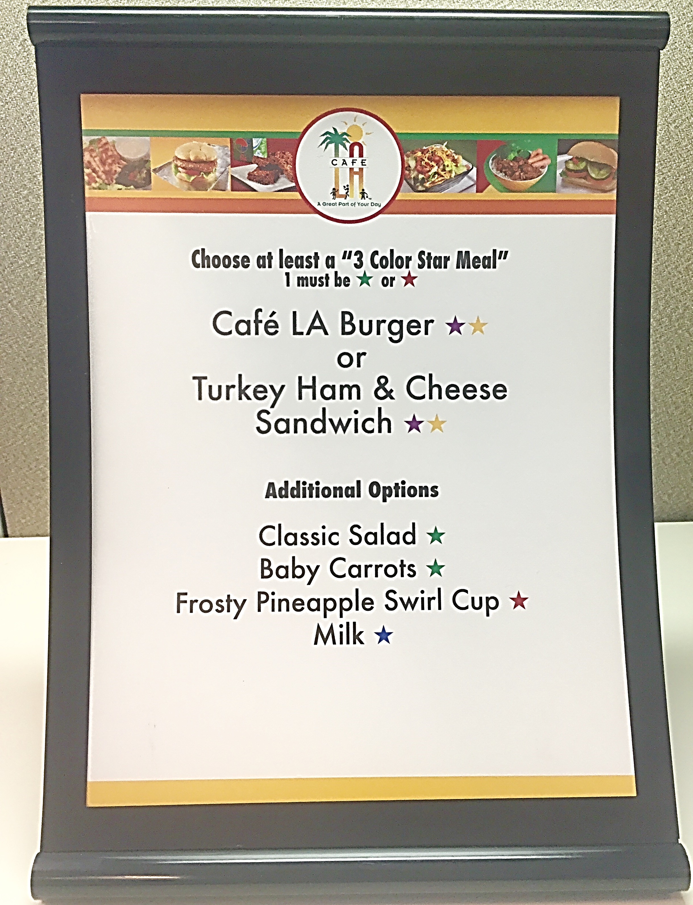
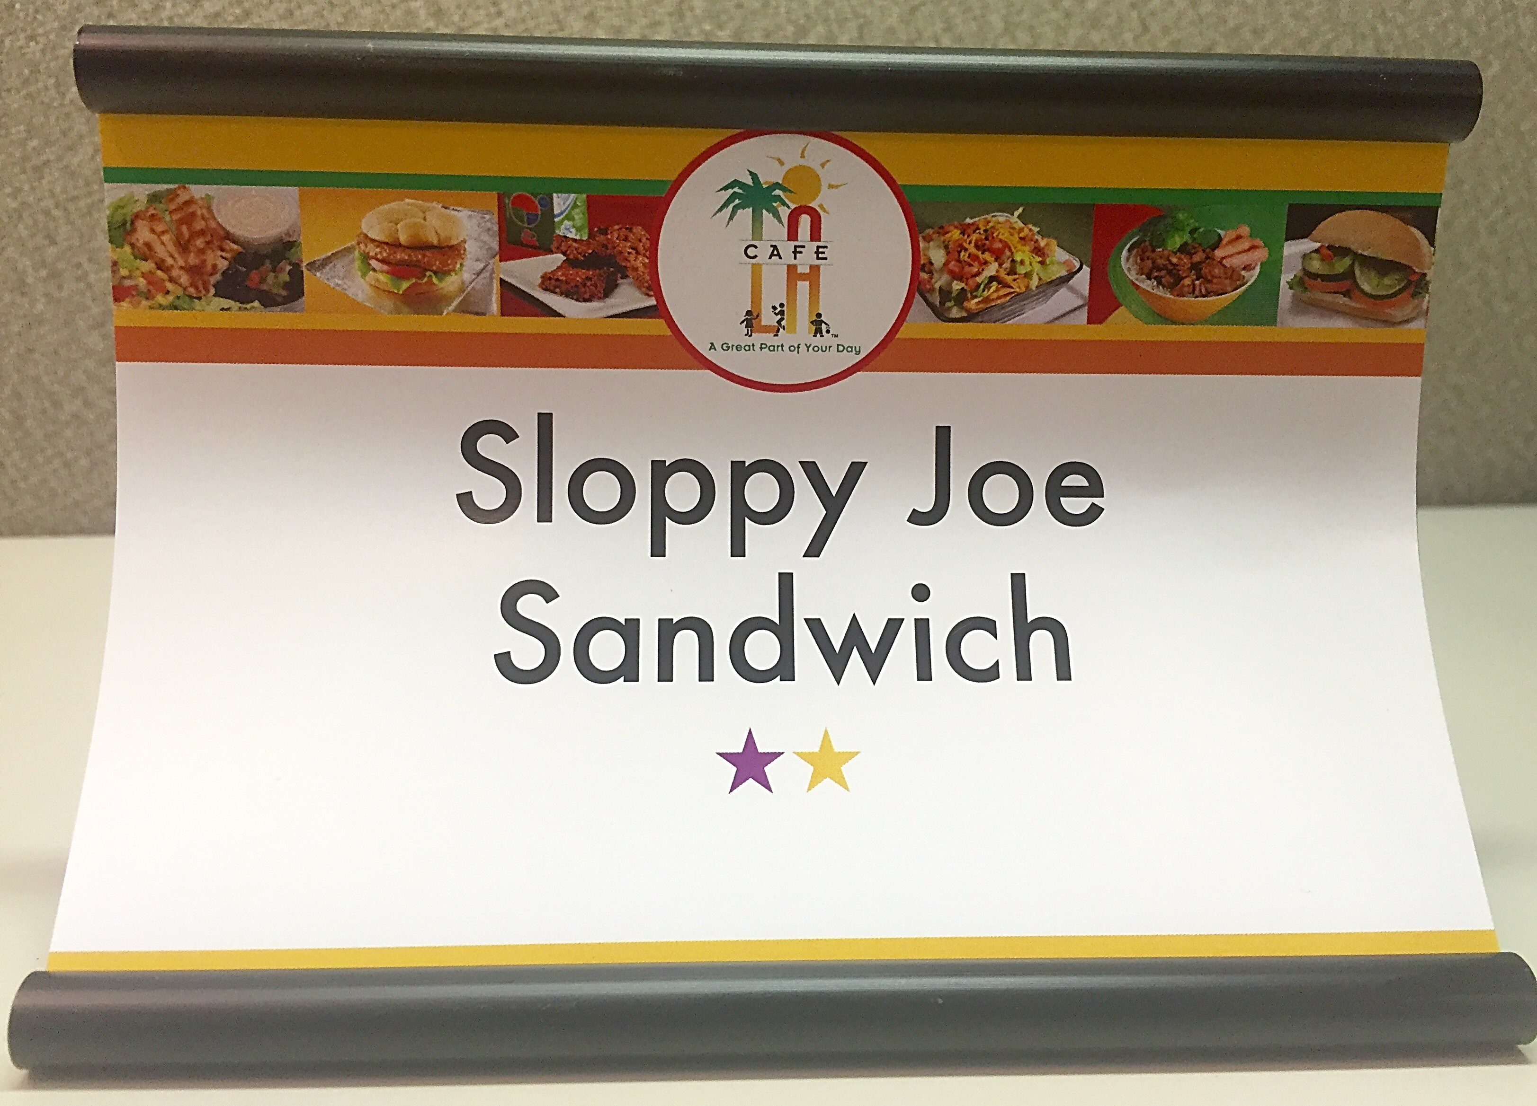
Posters & Signs
Posters and signs take steps to inform our customers on many factors such as:
Reimbursable meal requirements
Menu items with fun creative names
Colors that trigger appetite such as red, orange, yellow, and green
Notes:
TELL: Adding signage to your cafeteria is a great way of improving the look of your cafeteria. It’s something that students will remember because many times they look around as they wait in line for their food. This is an opportunity to catch their eyes with something that will be pleasing and create an appetite. Posters and signs also inform our customers on reimbursable meal requirements, menu items with fun creative names we are serving for the day and utilize colors that trigger appetite such as red, orange, yellow, and green.

Slide 32
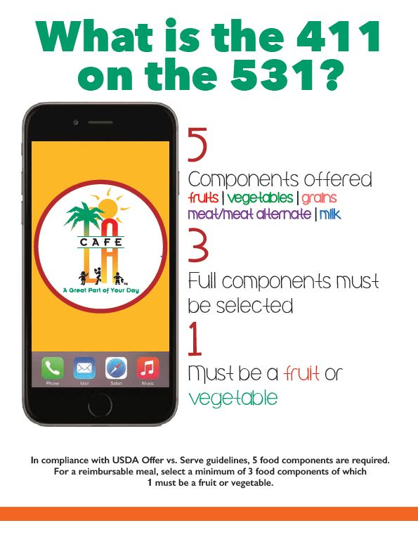
Looking Forward to New Posters
Notes:
Tell: Here, you can see 2 of the new posters that school sites will have to expand our physical brand and help students to select reimbursable meals. The two are easy for customers to identify and have images they can relate to very easily.

Slide 33
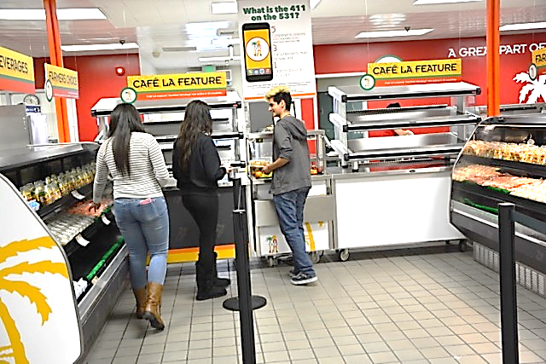
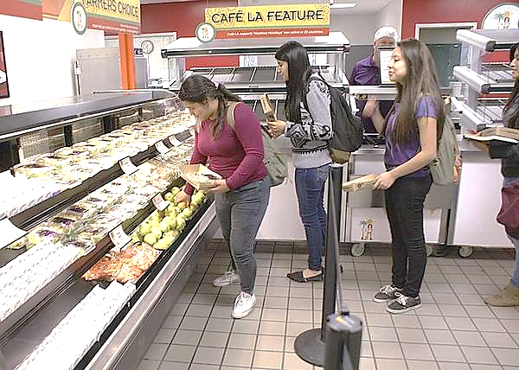
Cleanliness
Cleanliness was among the highest factors when it comes to affects on participation.
Remember to:
Maintain a clean working and serving environment
Communicate needs to the Plant Manager
Promote cleanliness to students that you serve
Notes:
TELL: We all know just how important cleanliness is anytime we go out to eat, so it is important to uphold a high level of attention to this detail in regards to your meal programs. Breakfast, lunch, and supper are all representations of Café LA, so be sure to maintain a clean working and serving environment. You’ll also want to communicate any needs to the Plant Manager regularly and establish a good rapport so that your goal is clear. Finally promote cleanliness to the students that you serve everyday, so they can develop these good habits in and out of the cafeteria.

Slide 34
Music and Decor
Popular music and seasonal décor help to make your cafeteria seem more welcoming. Decorate cafeterias tastefully and use music to:
Grab attention
Make wait times seem shorter
Speed up the line
Notes:
Tell: Use popular music and seasonal décor to help make your cafeteria seem more welcoming and personable. Additionally, decorating your cafeteria tastefully and playing popular music helps to grab the attention of new customers while making the wait times in line seem shorter. In fact, a studies have found that fast paced popular music increases the rate at which customers walk through your line.

Slide 35
Food Quality - The Gold Standard
What is the Gold Standard?
The optimal sample menu item from which other items are to be modeled after.
Follows standardized recipes
Why is the Gold Standard important?
Controls food & labor cost
Provides a visually appealing product
Notes:
Tell: The Gold Standard is a proven technique that will allow you and your staff to deliver a standardized product customers will enjoy consistently, this really has an effect on increasing participation. What is the gold standard? The gold standard is the optimal sample plate from which other plates are to be modeled. It is important because the Gold Standard helps us to control cost in terms of food and labor, follow standardized recipes, and provide customers with a product they can enjoy in every aspect. The product meeting the gold standard will allow for consistency and will increase customer satisfaction which increases participation.

Slide 36
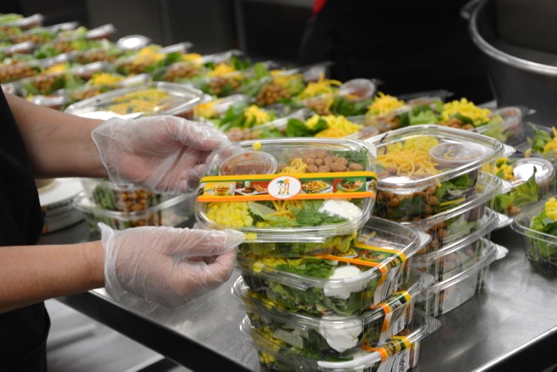
Activity – The Gold Standard
Do the following menu
items represent what a gold standard item would look like?
Click on the correct answer below to continue
YES
OR
Notes:
TELL: Do the following plates represent what a gold standard plate would look like?
Click on the correct answer below to continue

Slide 37
Activity – The Gold Standard
YES
This photo is a great example of following the gold standard during production to ensure that menu items consistently look appealing.
Notes:
TELL: This photo is a great example of following the gold standard during production to ensure that plates consistently look appealing.

Slide 38
Timing
Long wait lines experienced during meal service can discourage customers from choosing to participate in your meal programs.
Small adjustments to your meal service will translate to large increases in participation, focus on:
Proper line set-up
Starting meal service on time
Increasing the speed of service
Notes:
Tell: Long wait lines experienced during meal service can discourage customers from choosing to participate in your meal programs. Making small adjustments to your meal service will translate to large increases in participation by focusing on the proper line set-up prior to meal service, starting your meal service on time, and increasing the speed at which you serve your customers.

Slide 39
Value & Price
Educating your customers on the value of a Café LA meal will lead to an increase in participation. Take the time to educate your primary, external, and internal customers so they are aware of the:
Benefits of free or reduced price status
Full nutritional benefit of a complete meal
Value of a Café LA reimbursable meal
Notes:
Tell: A lot of our customers at all levels are not always sure of the value and prices of our meals. Take the time to educate your primary, external, and internal customers of the value of free or reduced price meal benefits. Complete the education of your customers by reminding them of the nutritional benefits obtained when a child gets a complete Café LA meal.

Slide 40
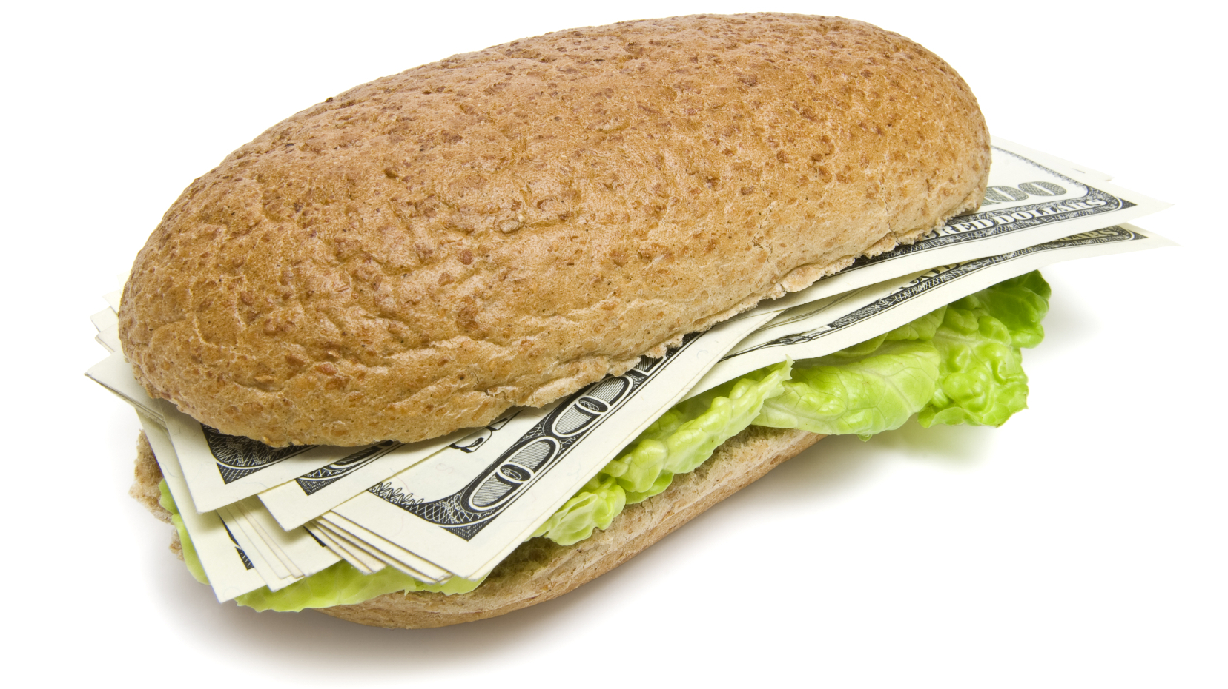
The Café LA Value
Price comparison of a deli sandwich and a Café LA reimbursable meal.
Market Deli Sandwich | Cost | Café LA Meal | Cost
2 Slices of mixed grain bread | $0.49 | Turkey sandwich with lettuce and tomato Including Applesauce cup & milk | $1.68
4 Slices of 2 oz. turkey ham | $2.01
1 Tbsp. mayonnaise | $0.14
3 Leaves of iceberg lettuce and tomato | $0.15
Deli Cost Total | $2.79
Market Deli Price (mark up - 283%) | $7.90 | Full Price Complete Meal Elementary Middle 6-8 High School 9-12 | $2.75 $3.00 $3.25
Savings of up to $5.15
Notes:
Tell: I have a very special gift for you today. It’s not the money sandwich shown here, sorry, but this sandwich is what parents are sending some of our students to school with. (animation 1) This chart compares the cost of a Market Deli sandwich, $7.90; and a reimbursable Café LA meal which also consist of a turkey sandwich, applesauce fruit cup, and milk for a maximum price of $3.25, depending on the grade level and eligibility of the student. This provides students with a potential savings of up to $5.15! That’s the Café LA value!

Slide 41
Every Meal Makes A Difference
Feeding 3 more students each meal period at every one of our 682 school cafeterias would provide 2046 more meals to LAUSD students each day results in:
Feeding 368,280 more students annually
Generating an additional $3,115,059.55 annually
You can make a difference with one meal, one student at a time.
Notes:
Tell: Every meal makes a difference! Use the strategies and techniques of this presentation to attract more students to your Café LA. Feeding just 3 more students each meal period throughout our 682 school cafeterias would provide 2046 more meals to LAUSD students each day which means 368,280 more students will get a nutritional meal. Additionally, these 3 meals would generate $3,115,059.55 annually for the Food Services Division. You can make a difference with one meal, one student at a time.

Slide 42
References
Brian Wansink, PhD David Just, PhD Laura Smith, BS
http://www.restaurant.org/Manage-My-Restaurant/Marketing-Sales/In-Store-Experience/6-tips-to-make-the-most-of-point-of-sale-signage
http://www.restaurant.org/Manage-My-Restaurant/Marketing-Sales/Specialty-Promotions/Plug-into-Gen-Z-diners-interests
http://www.restaurant.org/Manage-My-Restaurant/Marketing-Sales/Specialty-Promotions/Plug-into-Gen-Z-diners-interests
http://www.restaurant.org/Manage-My-Restaurant/Marketing-Sales/Specialty-Promotions/Plug-into-Gen-Z-diners-interests
http://www.restaurant.org/Manage-My-Restaurant/Marketing-Sales/Specialty-Promotions/Plug-into-Gen-Z-diners-interests
Journal of Nutrition Education and Behavior , Volume 43 , Issue 4, S1
http://frac.org/federal-foodnutrition-programs/national-school-lunch-program/
http://www.savingsguide.com.ca/-eat-lunch-at-school/
Notes:
TELL: Here are some references that have helped in developing this resourceful training for you today.

Slide 43
Questions?
Thank you!
LAUSD Food Services Division
Nourishing Children to Achieve Excellence
Notes:
TELL: Thank you for joining us for our maximizing participation training. If you have any additional questions, please contact

Slide 44
Incorrect
Please click anywhere to continue
Notes:
Tell: Incorrect, please click anywhere to continue.

Slide 45
Incorrect
Please click anywhere to continue
Notes:
Tell: Incorrect, please click anywhere to continue.

Slide 46
Incorrect
Please click anywhere to continue
Notes:
Tell: Incorrect, please click anywhere to continue.

Slide 47
Correct!
Diagnose:
Determine what is already working and what is not.
Click anywhere to continue
Notes:
Tell: Correct! Diagnosing is determining what is already working and what is not.
Click anywhere to continue

Slide 48
Correct!
Implement:
Make easy changes which complement your meal program and lead to an increase in participation.
You realize on Tuesday and Wednesday you are serving the non-perishable Goldstar items so you change it to fresh for the next order.
Click anywhere to continue
Notes:
Tell: Correct! Implementing is making easy changes which complement your meal program and lead to an increase in participation.
Click anywhere to continue

Slide 49
Correct!
Prescribe: Recommending changes that could lead to increasing participation.
Review menu’s for the 2 days in question to determine difference
Click anywhere to continue
Notes:
Tell: Correct! Prescribing is recommending changes that could lead to increasing participation.
Click anywhere to continue

Slide 50
Correct!
Evaluate:
Measuring and analyzing how the changes influence a difference in participation counts after implementation.
Click anywhere to continue
Notes:
Tell: Correct! Evaluating is measuring and analyzing how the changes influence a change in numbers before and after implementation.
Now, lets look at all the pieces of DPIE together and evaluate the changes this could make in our cafeteria.
Click anywhere to continue

